Slide 1







Model and observation for Surface Atmosphere Interactions
2021-2025
Fabienne Lohou
LOTHON M., BASTIN S., BRUT A., CANUT G., CHERUY F., COHARD J.-M., COUVREUX F., DARROZES J., DUPONT J.-C., LAFONT S., ROEHRIG R., ROMÁN-CASCÓN C.,
and MOSAI team

Slide 2
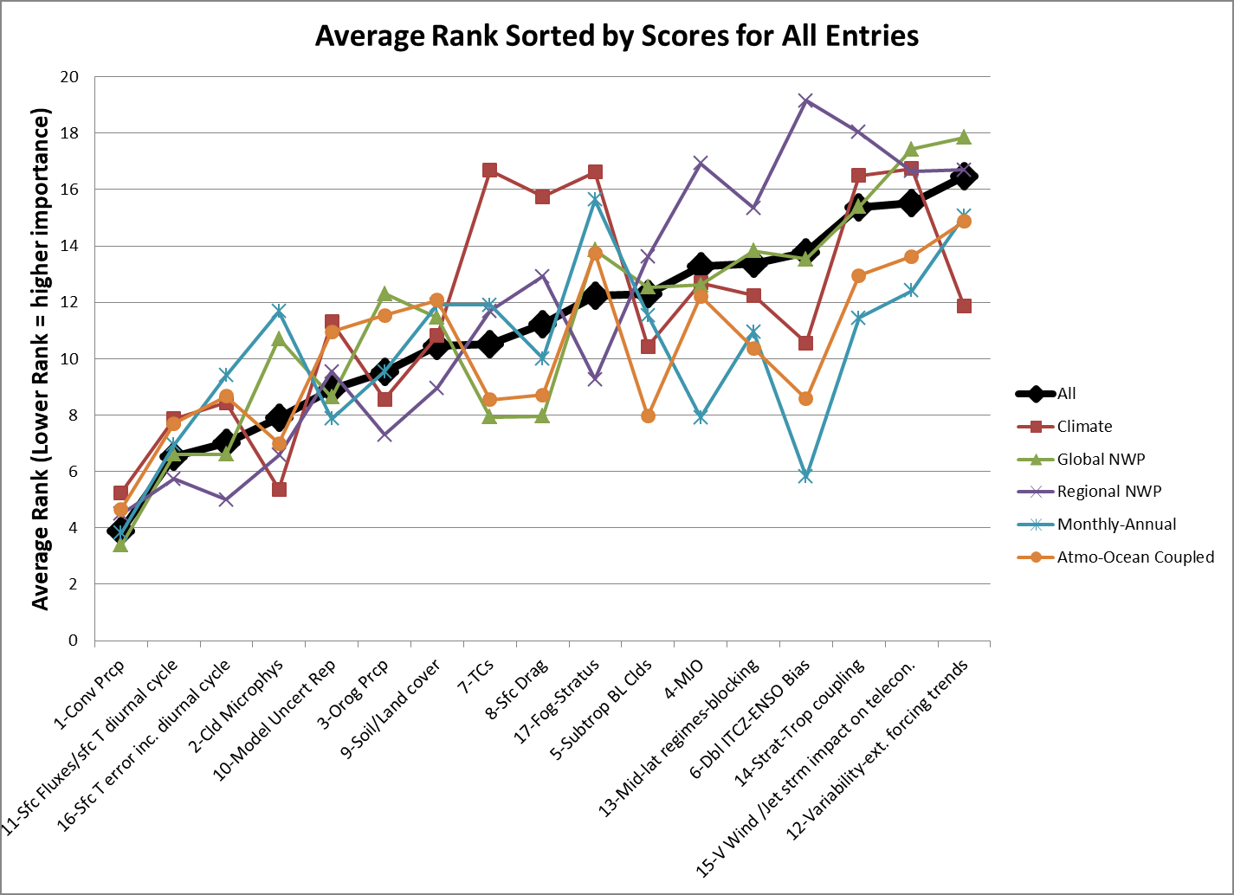
Motivations
Objectives
Means
Working Group on Numerical Experimentation (Fev. 2019)
MOSAI
2- Surf. flx – surf. T. diur.
1- Convection – precipit.

Slide 3
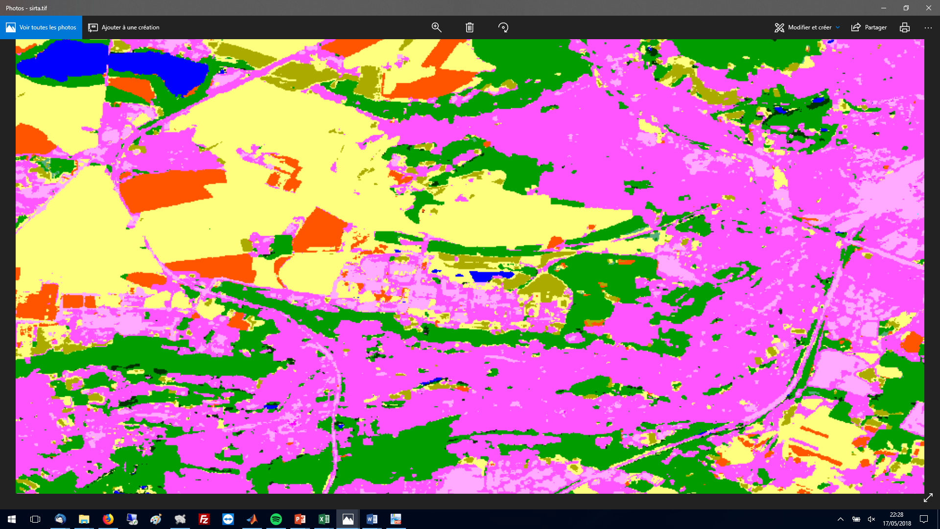
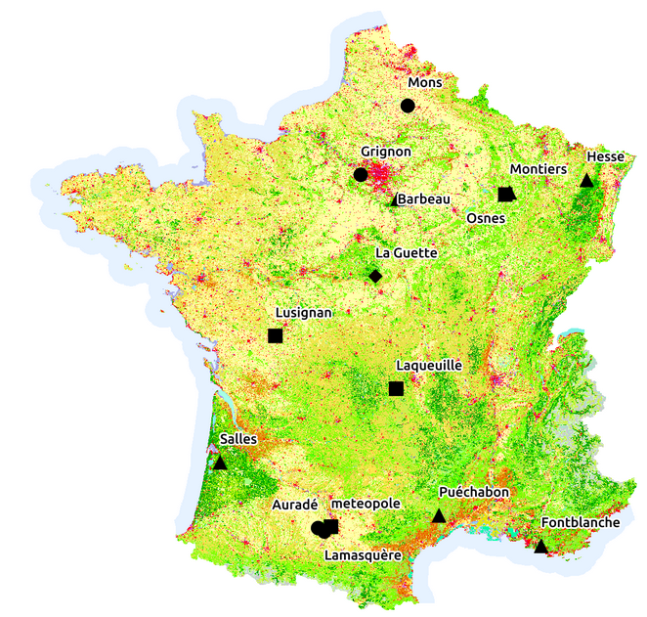


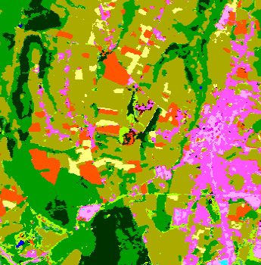
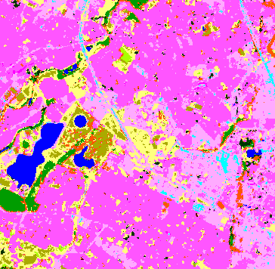
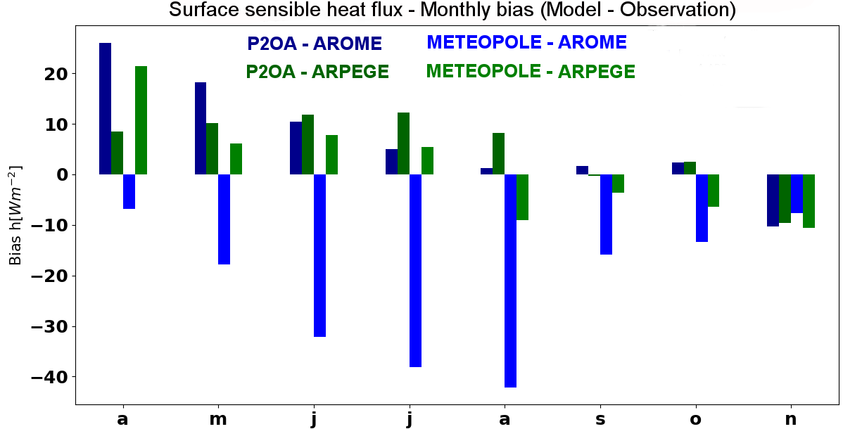
Motivations
Objectives
Means
SIRTA (IPSL)
Suburban
Land use map
(Sentinel-2)
Urban
5 km
Forest
Grass
Crops
5 km
P2OA (UT3/OMP)
Rural
METEOPOLE-FLUX
Urban
Monthly Biais (Model – Observations) for sensible heat flux
©Guylaine Canut

Slide 4
Motivations
Objectives
Means
1 – Measurement
3 - Improvement of the L-A models coupling
2 – Method for model evaluation using long-term measurements

Slide 5
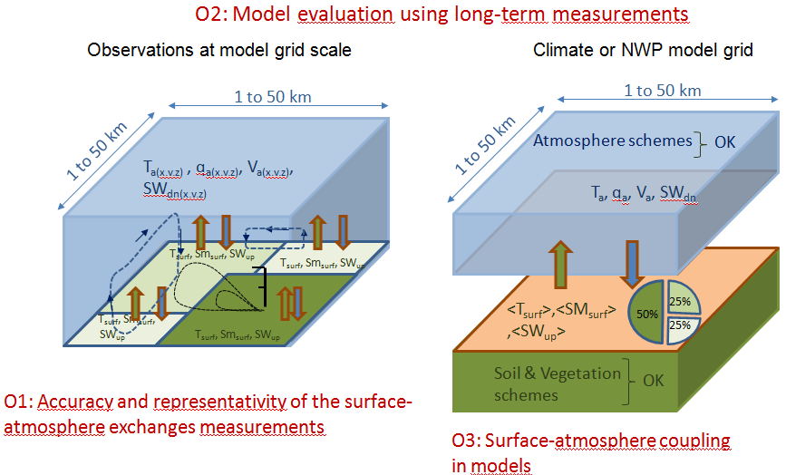
Motivations
Objectives
Means
1 – Measurement
3 - Improvement of the L-A models coupling
2 – Method for model evaluation using long-term measurements
GOAL # 1
Built reference turbulent heat flux data set for model evaluation
Patton et al., 2005; Liu et al, 2011; Maronga and Raasch, 2013; Cuxart et al., 2016
Bou-Zeid et al., 2020

Slide 6
Motivations
Objectives
Means
1 – Measurement
3 - Improvement of the L-A models coupling
2 – Method for model evaluation using long-term measurements
GOAL #2
Provide Dataset and Methodology to diagnose the reasons for bias

Slide 7
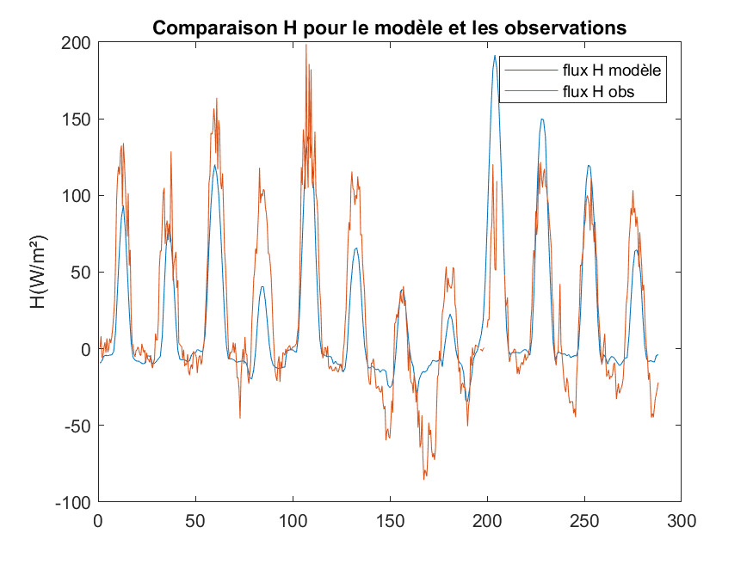
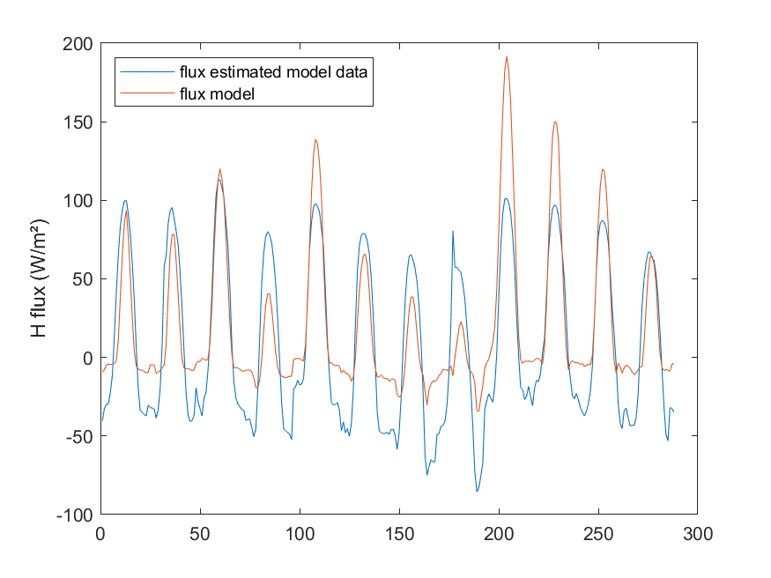
Motivations
Objectives
Means
1 – Measurement
3 - Improvement of the L-A models coupling
2 – Method for model evaluation using long-term measurements
WRF Simulated H – Observed H
ANN Training with Observations
150
Observed
meteorological data
Observed H
&
100
50
0
-50
ANN trained with observations
12 days of BLLAST campaign
WRF Simulated H – WRF_ANN H
150
100
WRF_ANN
H
WRF
meteorological data
50
0
-50
ANN applied to WRF MTO data

Slide 8
Motivations
Objectives
Means
1 – Measurement
3 - Improvement of the L-A models coupling
2 – Method for model evaluation using long-term measurements
GOAL #3
Try these improvements on numerical weather and climate models
25%
25%

Slide 9

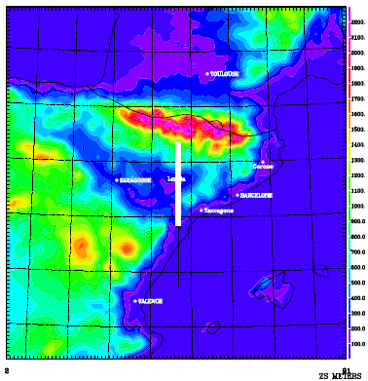
Permanent Observations
~ 10 years
Motivations
Objectives
Means
SIRTA: suburbain
Enhanced Observations
~ 1 year
P2OA: rural
SURFACE HETEROGENEITY
2023
MTO: urban
Intensive Observations
LIAISE
VERTICAL STRUCTURE
(Aaron Boone)
Numerical Models
2021
Méso-NH/ SURFEX ; LES
WRF / ORCHIDEE; Régional
AROME / SURFEX; Regional
ARPEGE / SURFEX; Cimate
LMDZ / ORCHIDEE; Climate
DYNAMICO / ORCHIDEE; Climate

Slide 10

Contact:
Fabienne LOHOU / LAERO, France
Web site & Data base: https://mosai.aeris-data.fr/

